Slide 1
Annual Principals and Deputy Principals Conference
Mobile Technology in ETB Schools
Wednesday 29 January 2020
Clayton Whites Hotel, Abbey Street, Co. Wexford

Slide 2
Let’s Start!
Format of this Session
Story of a successful 1:1 school experience
Discussion
Prompts
Solutions-focused

Slide 3
Some Recent Data on Technology

Slide 4
Some Recent Data on Technology
The five largest Fortune 500 technology companies - Apple, Amazon, Google, Microsoft and Facebook - currently boast a market of $4.7 trillion, compared with about $800 billion for the top five in 2010.
There are 5 billion smartphones in use around the world, according to Canalys Research
Mobile data usage has jumped almost nine-fold between 2013 and 2018
Global shipments of digital cameras dropped from their 2010 peak of 121 million to just 19 million units in 2018, according to the Camera & Imaging Products Association (CIPA)
Google reports that its Android devices take 93 million selfies every day.
The number of available emojis has nearly tripled to almost 3,000 since 2010
The total number of minutes spent on voice calls in UK fell from 254 billion in 2013 to 206 billion in 2018, and the number of text messages dropped from 129 billion to 74 billion over the same period, according to Ofcom.

Slide 5
Our Connected World
A Mobile World

Slide 7
What is Mobile Technology or Mlearning ?

Slide 8
Defining Mobile Technology - Mlearning
“e-learning that adopts the use of mobile technology to achieve anytime, anywhere, ubiquitous learning and that emphasises learners’ mobility and personalised learning”
(Vázquez-Cano, 2014)

Slide 9
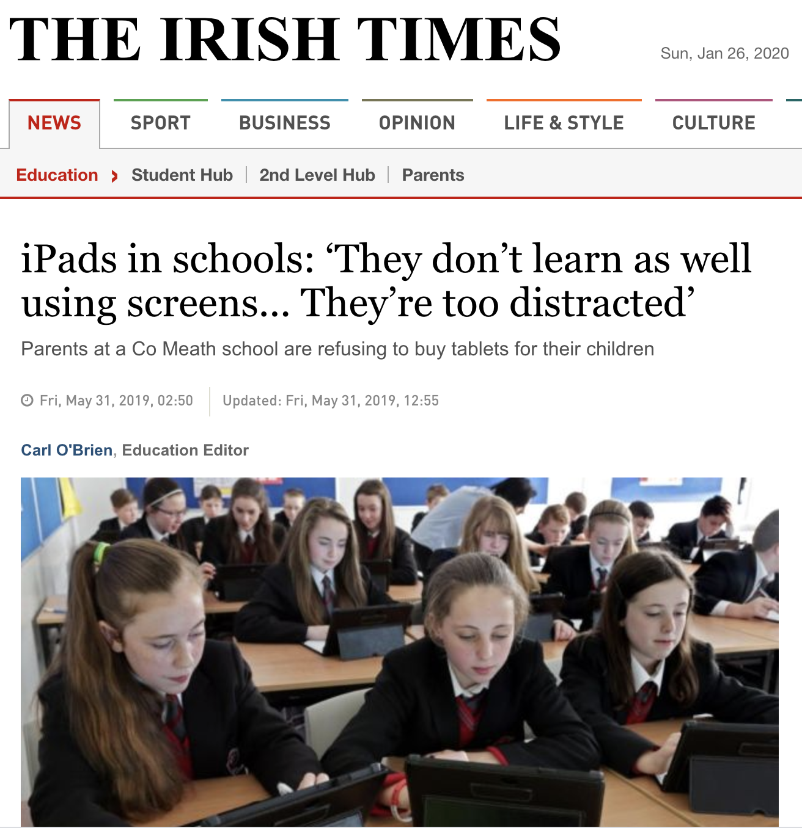
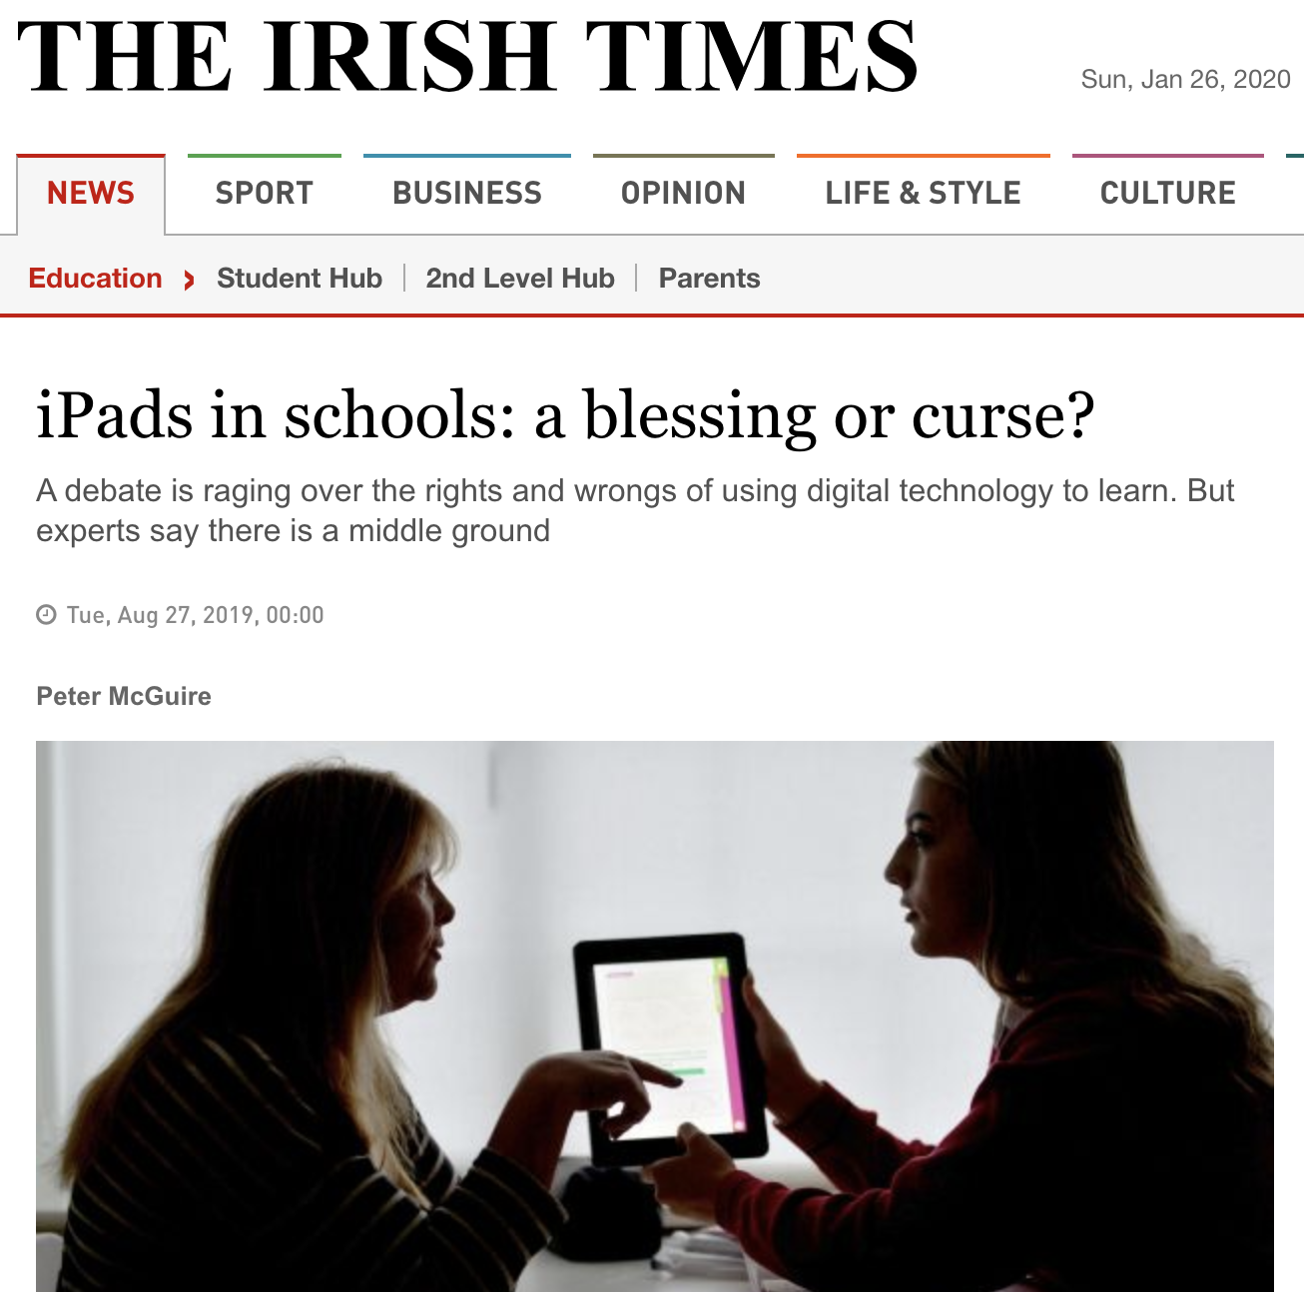
Recent Headlines on Mobile Technology

Slide 10
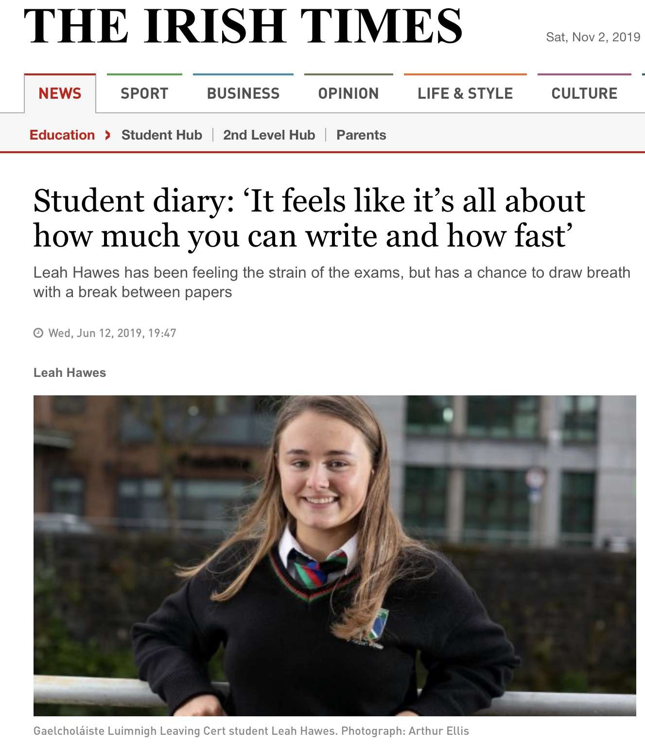
Type to enter a caption.

Slide 11
Your Context
Click onto menti.com
Meeting Number: 53 07 93

Slide 12
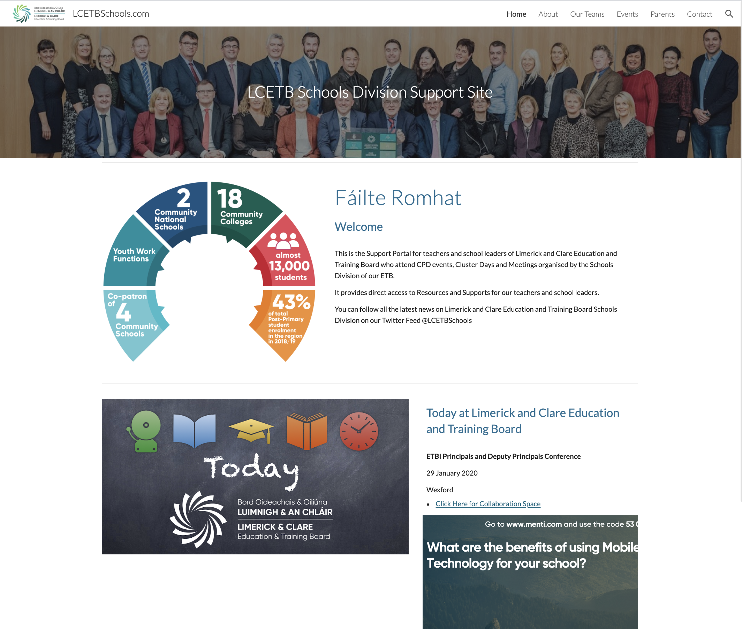
On-line Resource for Today
www.lcetbschools.com

Slide 13
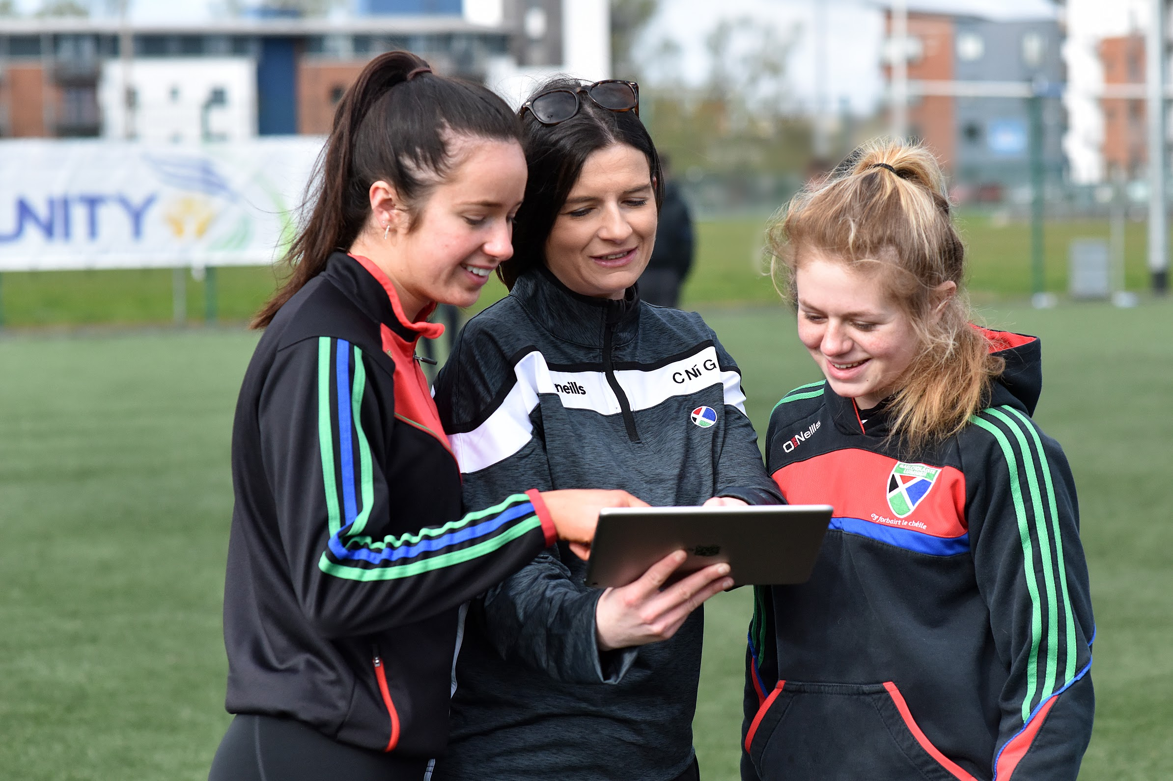
Mobile Technology in Schools
Why?

Slide 14
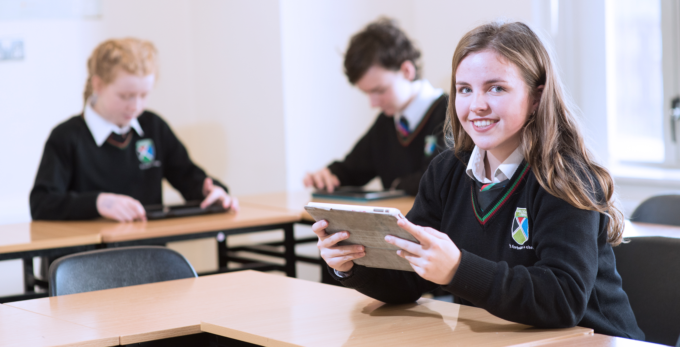
Best School
Learning is personalised & Teaching is innovative

Slide 15
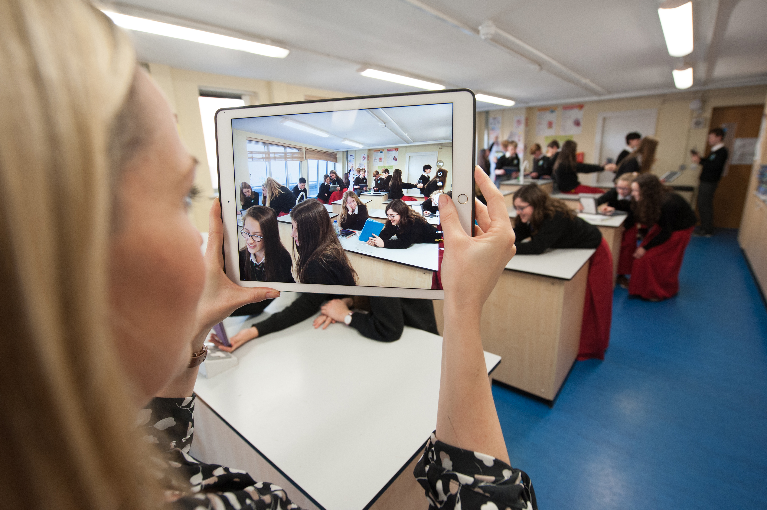
Overcoming barriers
It always goes back to our Vision
Promoting Vision for School Community
Consulting Stakeholders & Gathering Data
Re-imagining Traditional Tasks & Workflows
CPD
Using local Resources as a ‘Springboard’ for Staff

Slide 16
Managing Students
Challenges in integrating Technology
Clear policy for school community
Consulting stakeholders & responding to concerns
Dealing with breaches
Using SSE & LAOS to measure progress

Slide 17
How can we supporting staff?
Notes:
Sustaining Innovation
What is the school trying to achieve next and how are they going to do it?
Building on Apple Teacher
Swift
Learning Spaces
Pupils generating more of their personalised content

Slide 18
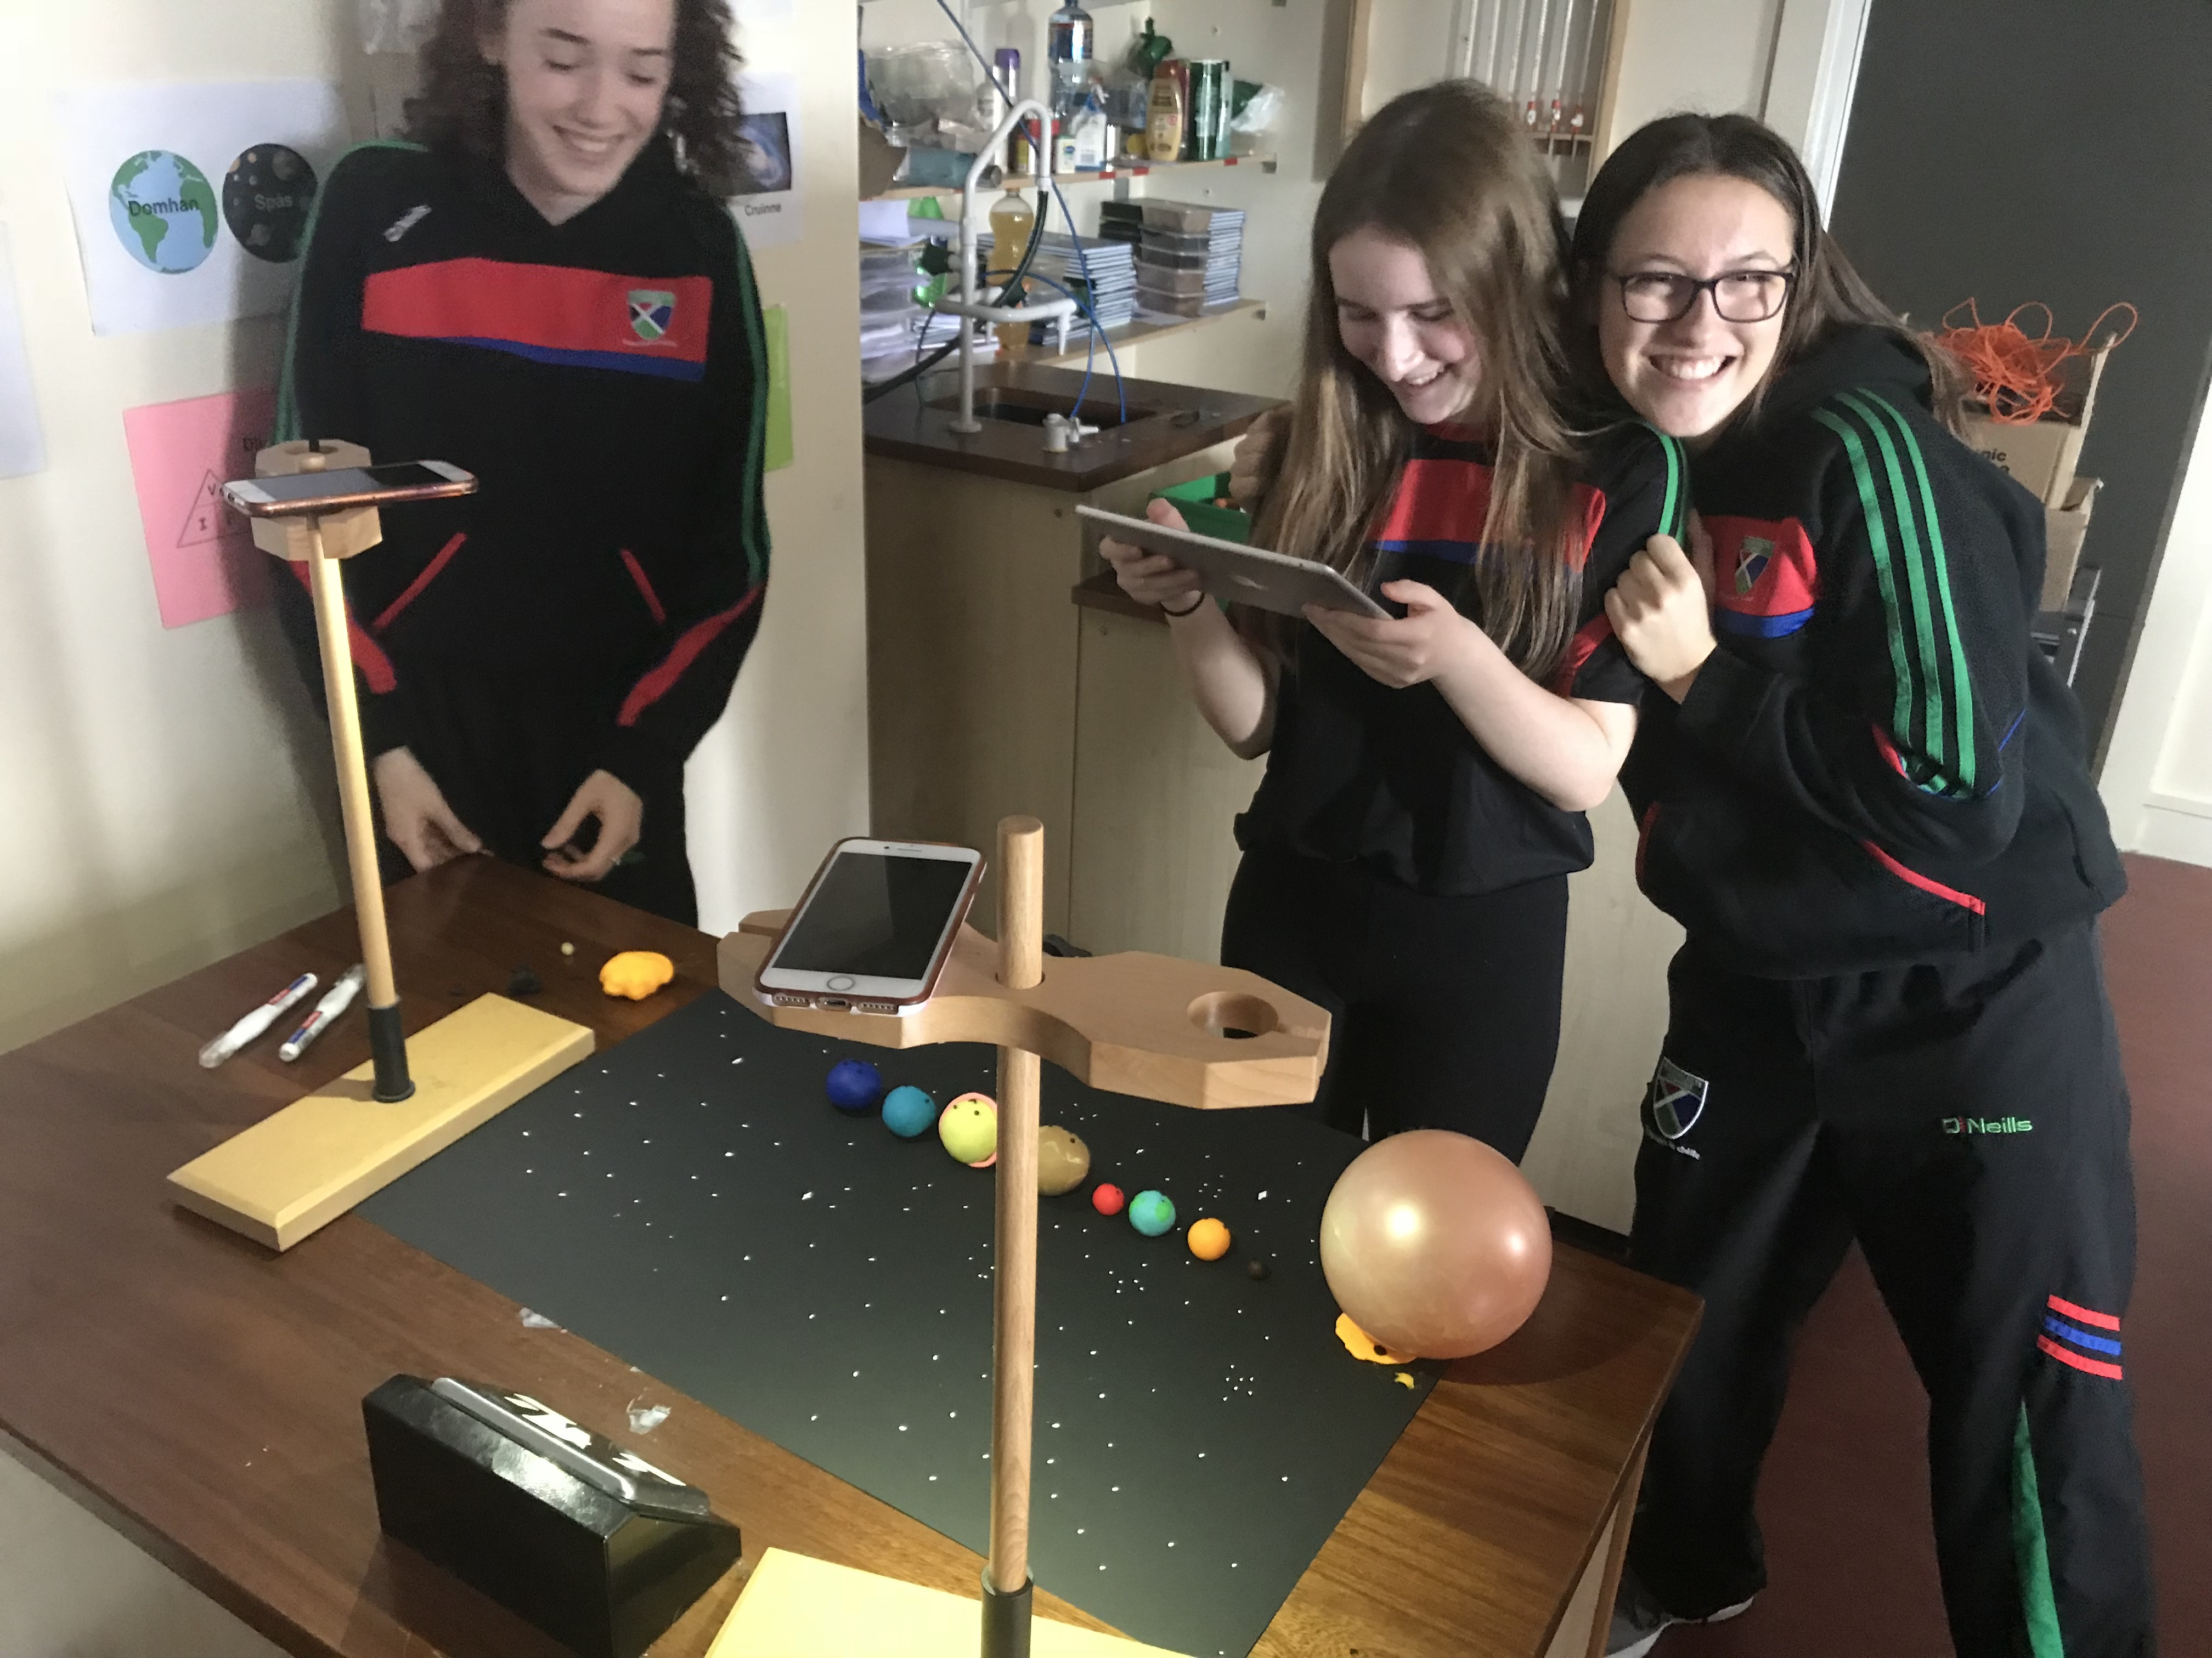
Planning for Succes
Reaching out to other schools that are recognised as being successful adopters of Mobile Learning - via PDST, Re-Sellers etc.
Pupils generating more personalised content
Promote a culture to collect more qualitative data from pupils, parents and staff to appraise how deeply the technology is impacting on pupils’ progress and enjoyment of learning.

Slide 19
Personalised & Creative like this!

Slide 20
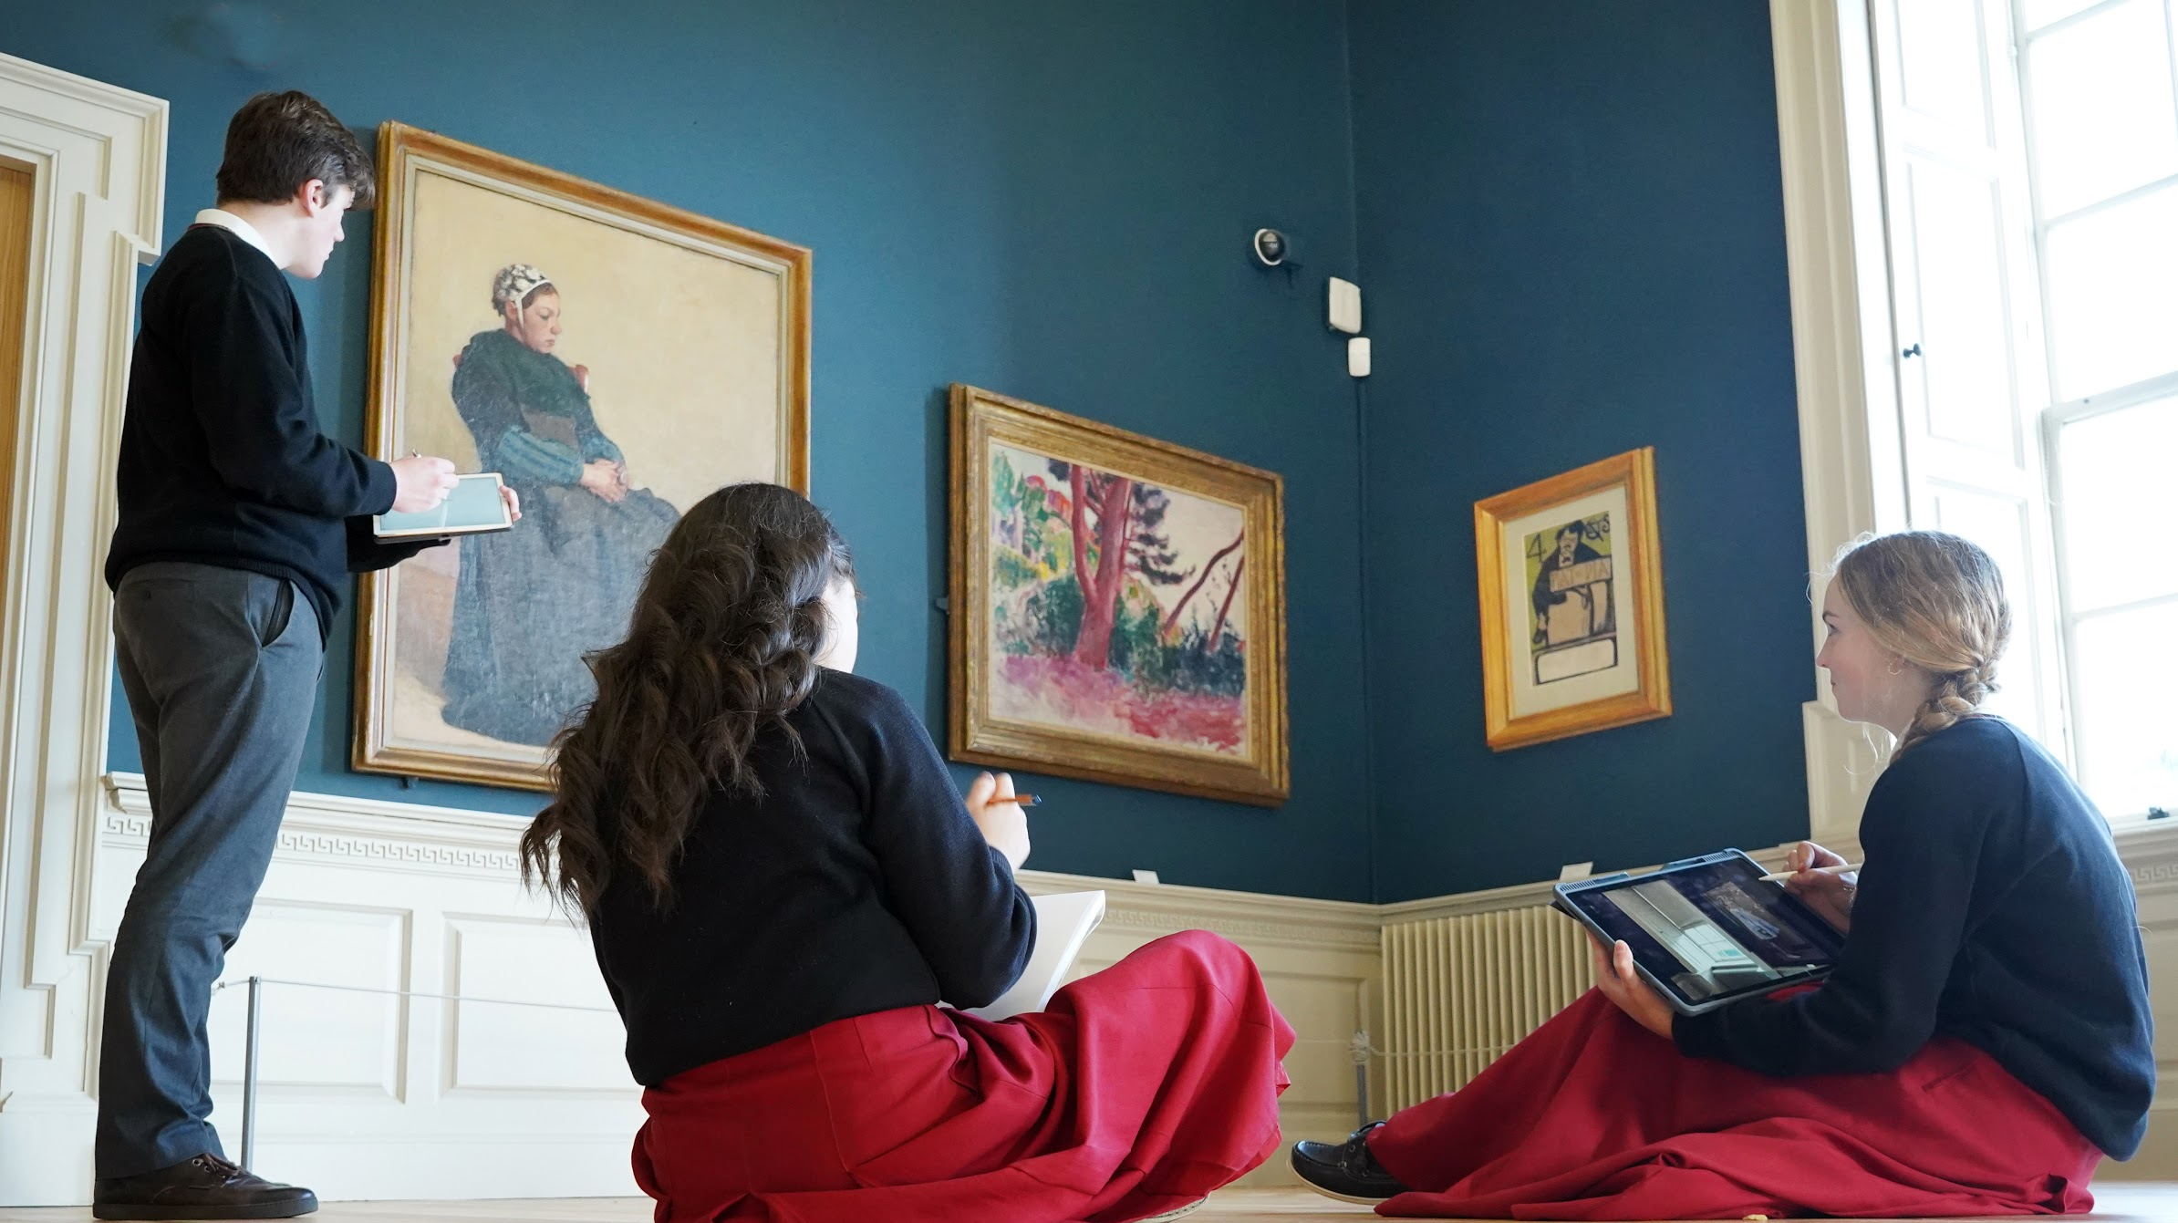
Learning Spaces

Slide 21
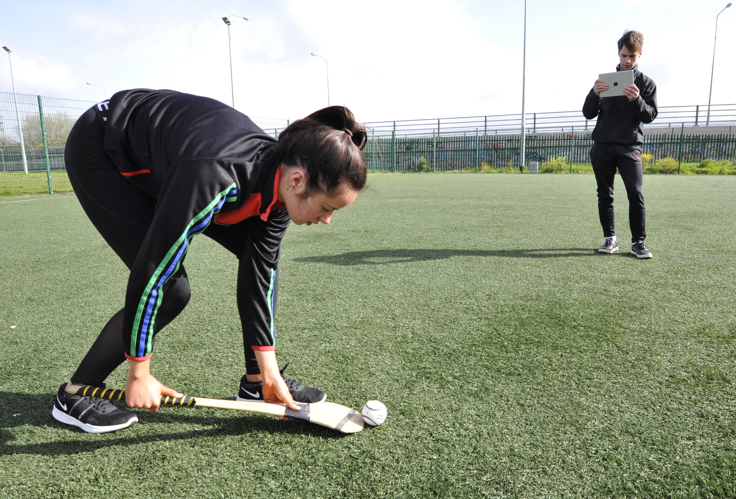
Results
Student, Parent & Community Feedback

Slide 22
Resellers - Essential Partnership

Slide 23
Microsoft - Google - Apple

Slide 24
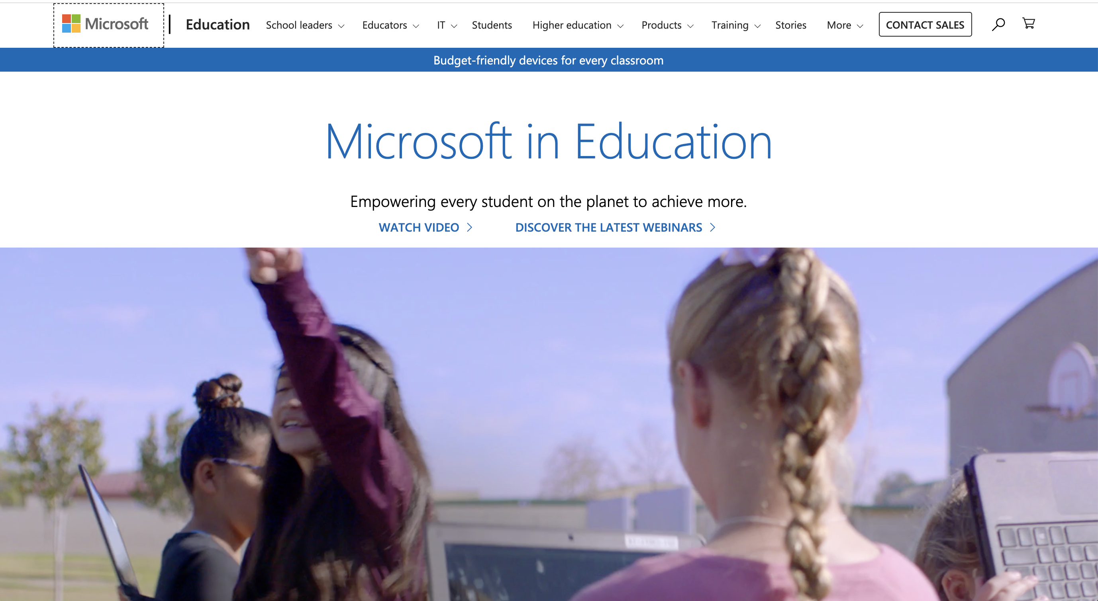

Slide 25
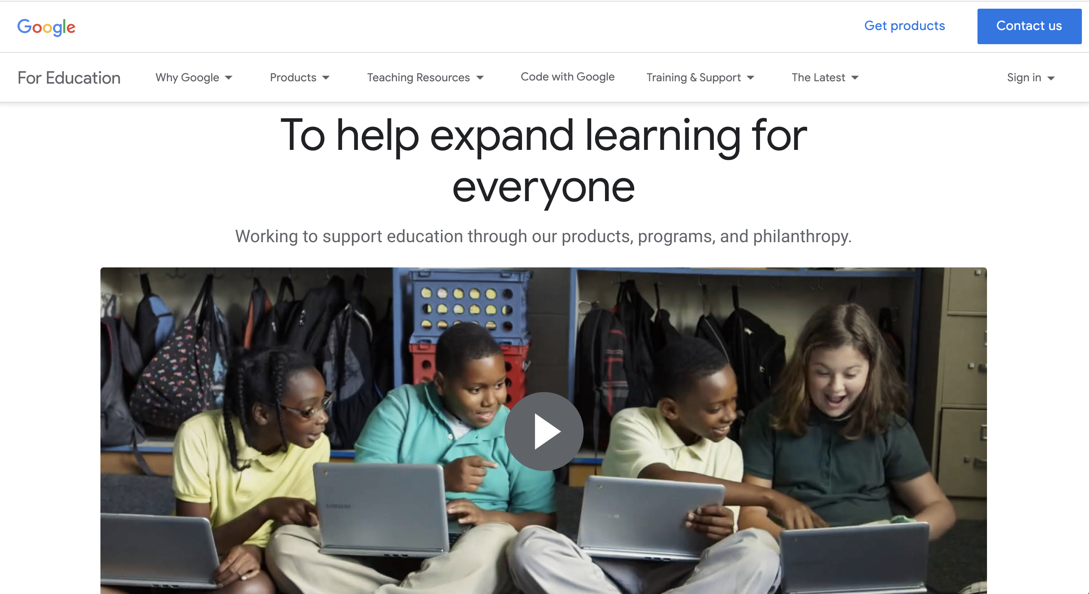

Slide 27
Additional Information
www.lcetbschools.com

Slide 28
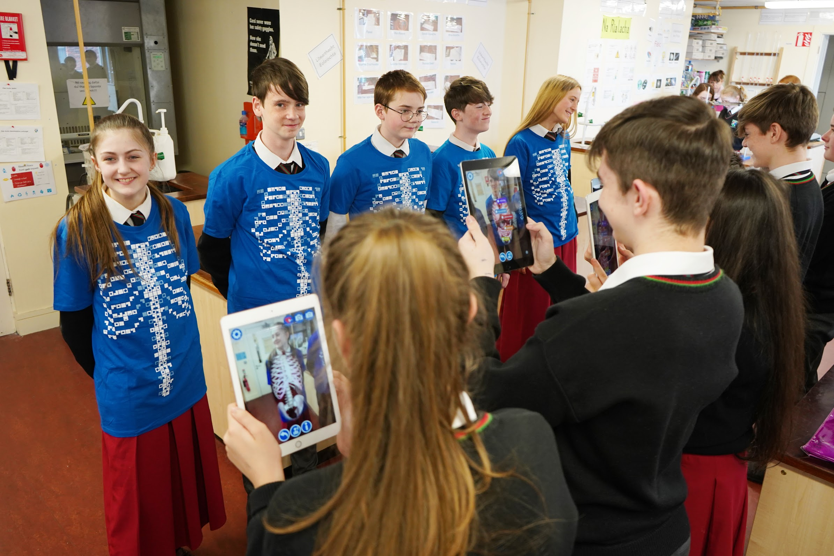
Go raibh maith agat!
Feel free to contact me anytime
Twitter: @LCETBschools
Website: lcetb.ie
Email: donncha.otreasaigh@lcetb.ie

Slide 29
Enjoy the rest of the Conference!

