Slide 1
Boards Self Reflection
through the lens of
LAOS
A Practical Approach
Jacqui Dillon

Slide 2
Looking at Our School 2016 A Quality Framework for Post-Primary Schools A tool to support reflection, self-review and evaluation
Notes:
LAOS Is the framework – SSE is the process
Engage in the process – refer to the framework in everything we do in schools
Any circular / initiative that comes in to schools – refer it to LAOS
In terms of managing change – this framework gives us the platform – it gives us the points for reflection and improvement – and we use the SSE process – those 5 steps to do this
Its about strategic planning -
New language for schools – new language for boards
LASO – SSE – Middle Management – Domains – standards – dimensions -
The language of pedagogy that’s now coming from JCT & Leaving Cert Review – Learning Intentions – Success criteria - cluster meetings
Use LAOS AS A GUIDE TO HELP US
Take an aspect – have it as a priority – feed it into our sse process – use it to reflect – to imrove – to move the school forward – use this same process with Boards – self reflection – identify the standard in LAOS – make it happen – will show you how this can be done today

Slide 3
Developing a quality framework for schools
Teaching & Learning
What is in Looking at Our School 2016?
A quality framework for schools
A basic conceptual structure
A set of clear, definable standards in two dimensions:
teaching and learning
leadership and management
Leadership & Management
Notes:
Focuses on the practices that experience and research indicate are most effective in providing (and leading) high quality education and ultimately in improving student outcomes

Slide 4
Developing a quality framework for schools
Why?
One set of standards for a range of functions
To bring consistency – shared understanding of what effective teaching, learning, leadership and management practices look like
Common language
To avoid duplication – for teachers, school leaders, management, patrons, inspectors, providers of ITE and CPD
To inform SSE and external evaluation
To be used selectively by professionals - not an inflexible checklist

Slide 5
LAOS
Dimension
Teaching and learning; leadership and management
Domain
4 Teaching and learning; 4 leadership and management
Standard
4x4 Teaching and learning; 4x4 leadership and management
Statement of Practice
Effective practice and highly effective practice
Notes:
Laos
This is the basis for all inspections
Sse is a process
Laos is the quality framework
USE THIS AT STAFF LEVEL TO GET THE LANGUAGE
2 DIMENSUIONS
4 DOMAINS WITH EACH HAVING 4 STANDARDS
STATEMENTS
EFFECTIVE AND HIGHLY EFFECTIVE PRACTICE
COULD HAVE THIS AS A ONE PAGER FOR STAFF
The quality framework refers generally to school leaders, and more specifically to school patrons, boards of management, principals and deputy principals, as appropriate. The quality framework is set out below

Slide 6
What’s involved in leading and managing a school?
Four domains, each with four standards
Establish an orderly, secure and healthy learning environment and maintain it through effective communication
Leading learning and teaching
Managing the organisation
Leading school development
Developing leadership capacity
Empower staff to take on and carry out leadership roles
Lead the school’s engagement in a continuous process of
self-evaluation
Notes:
THE STATEMENTS OF PRACTICE For each standard, statements of practice are given at two levels –
statements of effective practice
statements of highly effective practice.
The statements of effective practice describe practices operating at a competent and effective level. The statements of highly effective practice describe very effective and successful practices. The statements at the two levels differ in varying ways; some explanations and examples are given below.

Slide 7
It is a healthy sign of an organisation if it can engage in an honest analysis and review of its effectiveness in the achievement of its aims and objectives Kavanagh et al
Many boards of management have chosen to place School Self-Evaluation as a standing agenda item at all board meetings
Chief Inspectors Report
Notes:
WE ARE CONSTANTLY REVIEWING – THIS IS A HEALTHY SIGH
THIS ISINT EASY STUFF WITH STAFF
COS WHAT TEACHERS LIKE IS ROUTINE PROCESSES, IMPT THAT WE DON’T TRY AND CHANGE EVERYTHING AT ONE TIME, TEACHERS CAN ONLY COPE WITH ONE THING
Part of this sse process is Board Self Evaluation

Slide 8
- engaging in reflective enquiry on the work of the Board
A Boards self evaluation process should address the following key questions with regard to an aspect or aspects of its work:
How well are we doing?
How do we know?
How can we find out more?
What are our strengths?
What are our areas for improvement?
How can we improve?
Notes:
- an evidence-based approach - gathering information - making judgements to bring about improvements.

Slide 9
A task for discussion…
Think about
your own school and the objectives for enhancing the role of the Board
Reflect on:
What elements of the framework refer directly to the Board?
How might you begin to introduce the Quality Framework?

Slide 10
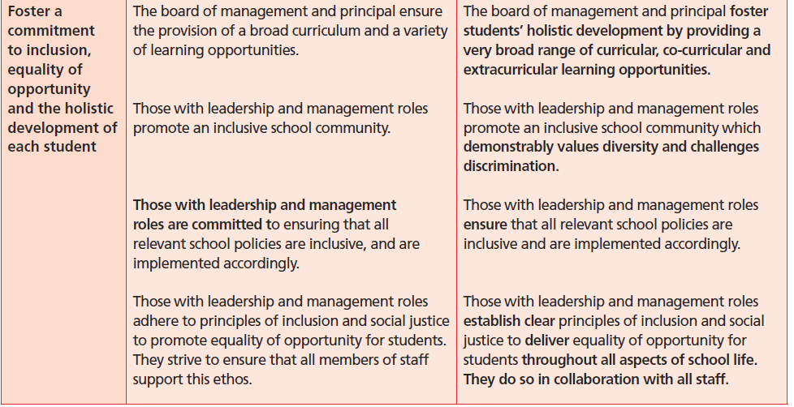

Slide 11
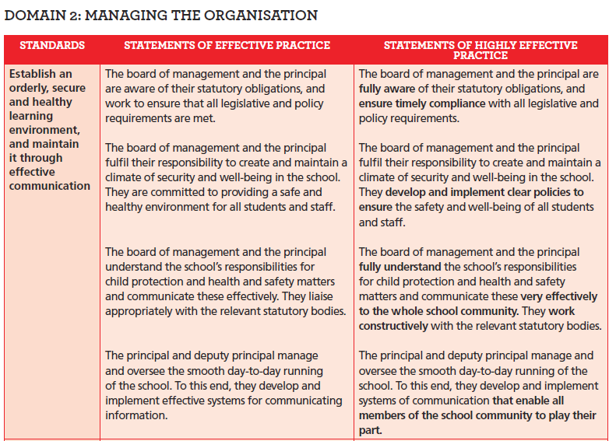

Slide 12
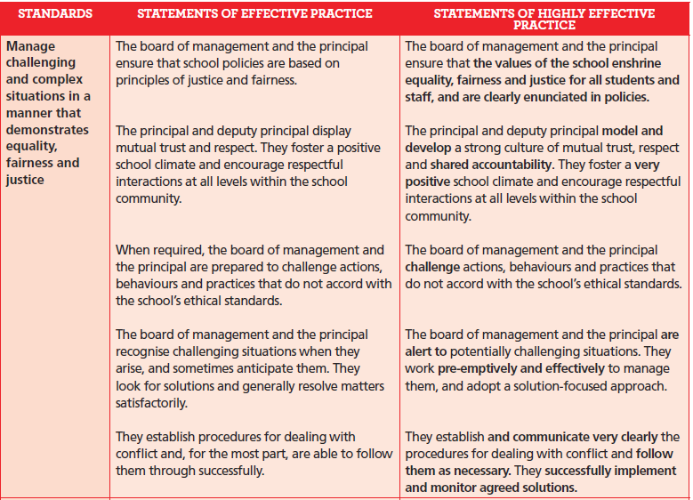

Slide 13
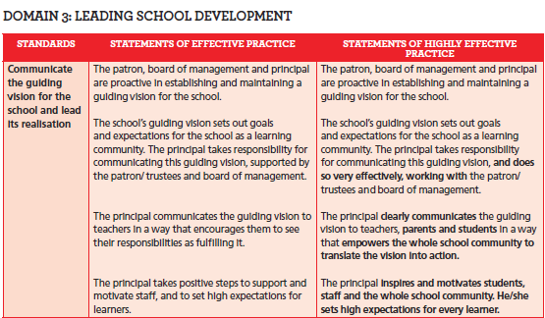

Slide 14
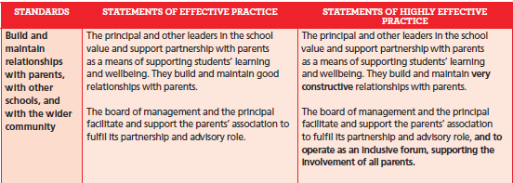

Slide 15
 |  | Agree Strongly | Area for Improvement
1 | Do I attend all meetings?
2 | I always read in advance Minutes and all other documents
3 | Meetings start on time and follow a set agenda
4 | I contribute to each meeting in a meaningful way
5 | We work effectively as a Board
6 | I am clear as to my role on the Board
7 | The Secretary carries out her/his duties in an effective manner
8 | The Chair carries out his/her duties in an effective manner
9 | Each nominee carries fulfils his/her role through effective engagement
10 | I understand and have engaged in the schools SSE process
Board of Management Self Review Toolkit

Slide 16
11 | I am aware of and understand the schools mission statement
12 | The Board is aware of the short and long term plans for the school
13 | I have availed of Board of Management training
14 | The Board reviews the annual state exam results
15 | Open discussion is allowed and encouraged
16 | I contribute to discussions and the decision making process of the Board
17 | I am aware of the school plan and its objectives/targets
18 | The Board has met with the Student Council
19 | The Board has met with the staff
20 | The Board has met with the Parents Association
21 | The needs of the students are regularly reviewed
22 | Supporting and development of the current curriculum is pivotal to the Boards business
Notes:
This self reflective questionnaire is based around the questions asked of boards during MLLs

Slide 17
23 | Staff receive an Agreed Report after each Board meeting
24 | Parents receive an Agreed Report after each meeting
25 | I am aware of and familiarise myself with current education legislation & DES Circulars
26 | I am aware of the schools targets in relation to the national Literacy & Numeracy Initiative
27 | I am familiar with the new Junior Cycle and its implications for teaching & learning
28 | I have read and familiarised myself with the ‘Brief Guide’ for ETB Board members
29 | I have a copy of and am familiar with the ‘Knowing my School’ booklet
30 | I am an effective Board member who works towards the betterment of the school/college/centre
Three key areas for development in the year ahead:
______________________
______________________
______________________
31 | I have attended Child Protection training for Boards
32 | I am familiar with those policy that are a statutory requirement for schools
Notes:
CP Inspections – being rolled out
E types
During an Incidental – teacher asked 1. What is their role 2. Who is the DLP 3.

Slide 18
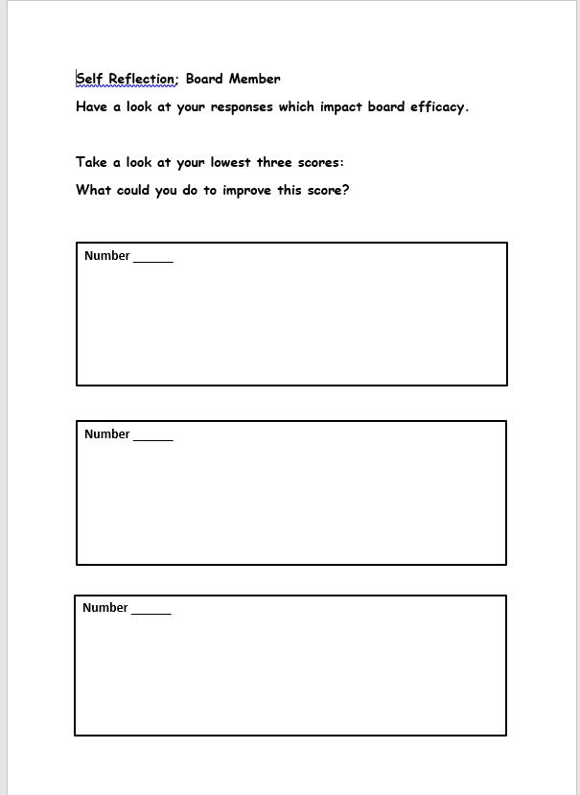

Slide 19
Go through the relevant standards with the Board in LAOS or Use Checklist
Agree on one standard and examine their statements of effective / highly effective practice
Ask the Board members to do a TPS
Feedback: Record on the flipchart paper how the Board members (on how they can be more effective & what support they would need to achieve this)
Discuss a possible strategy to support the Board move from effective to highly effective practice referenced in one of the statements
Add this process to the SIP as part of the SSE process

Slide 20
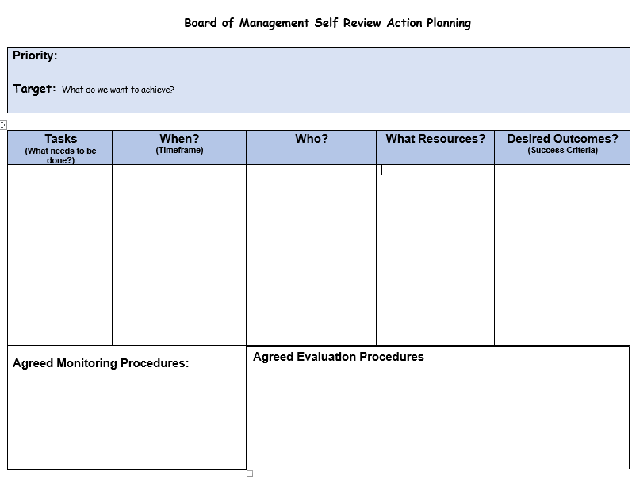
Notes:
Action plans sdpi.ie

Slide 21
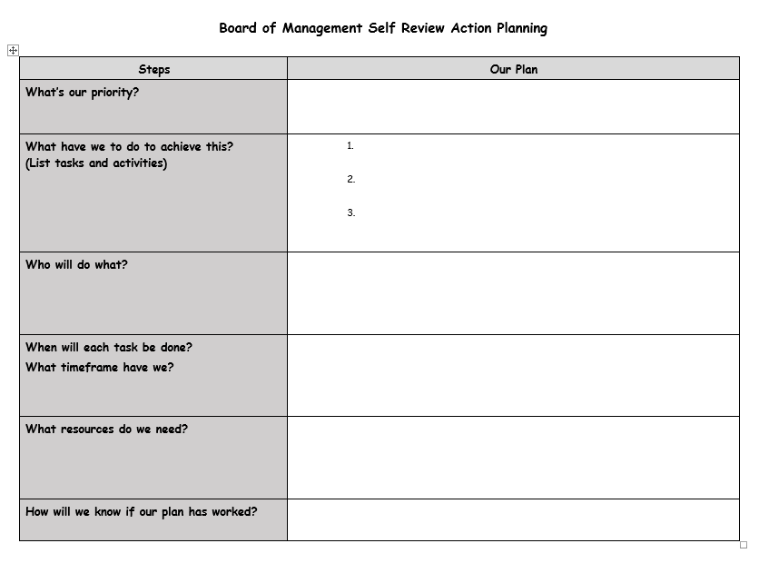

Slide 22
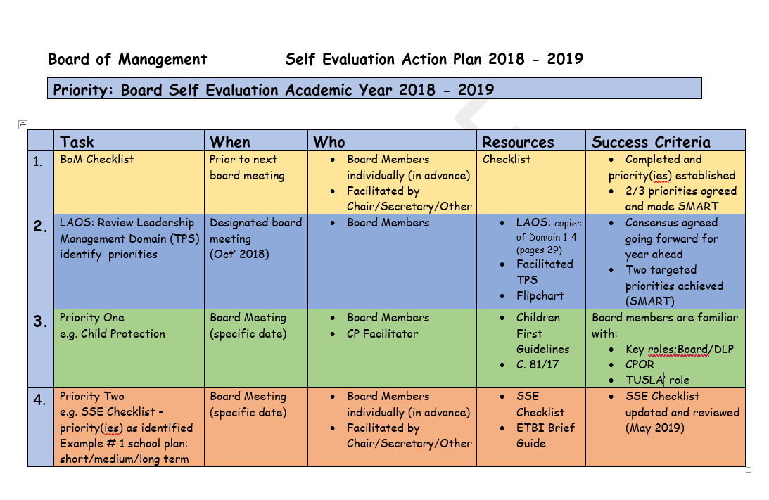

Slide 23
SSE The 6-step Process
Identify Priority
Evidence – the why
Action plan – the what
Set target(s)
Record all (SIP)
Review/evaluate progress (SSE)
Notes:
6 STEP PROCESS
BE ABLE TO ARTICULATE THIS

Slide 24
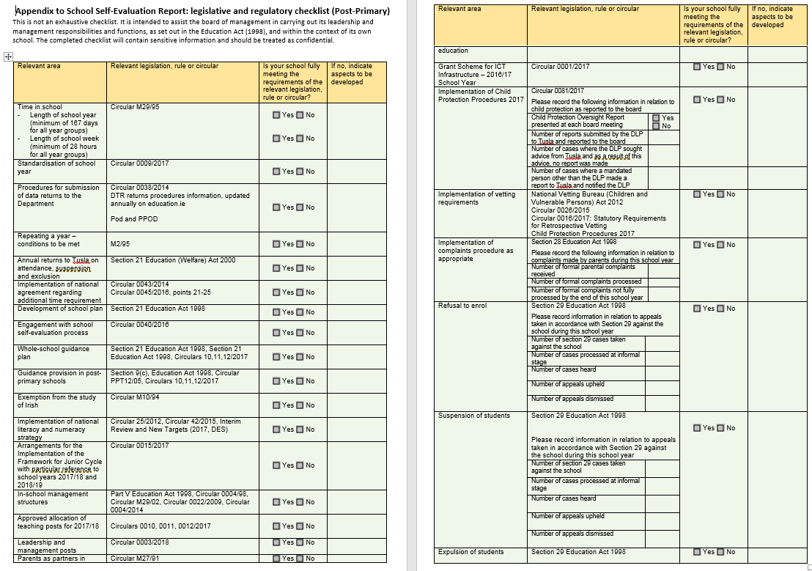

Slide 25
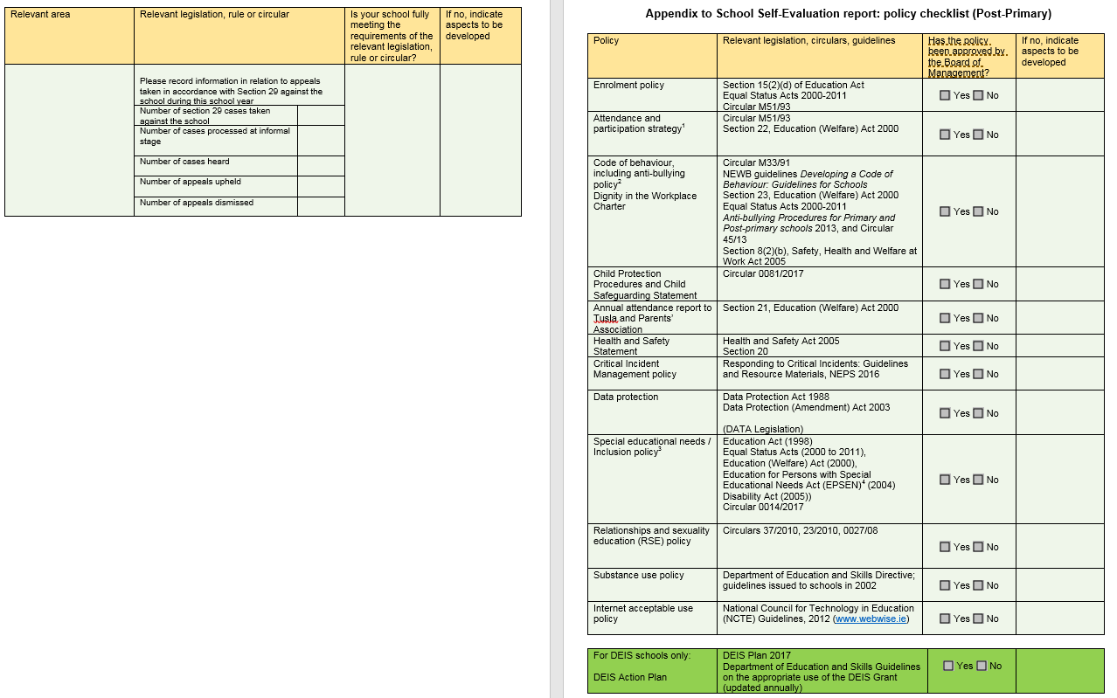

Slide 26
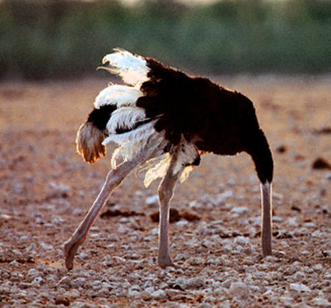
Notes:
Boards cannot claim ignorance – all members need to be fully engaged with the process. There is both an individual ad collective responsibility to engage with the role and be aware of - at the very least - what that responsibility / accountability involves

