Slide 1
National Centre for Guidance in Education ( NCGE)
Presentation to ETBI Principal’s Conference
Leaders’ Learning: Excellence in our schools
Jennifer McKenzie, Director
Linda Darbey, Guidance Programme Co-ordinator
31st January 2018

Slide 2
Presentation Overview
NCGE role and remit
Policy context informing this work
What we have done so far
Where we go next
Whole School Guidance Framework

Slide 3
NCGE
Agency of the Dept. of Education and Skills
Representative for Ireland in EU
AIMS
promote the implementation of best practice in guidance counselling in schools, centres for education, and Further Education and Training settings
advise on policy and strategies for the promotion of a continuum of guidance in the context of lifelong learning
ACTIVITIES
(i) inform and support the development of DES lifelong guidance policy in the education and training sector
(ii) develop and support quality guidance practice in post primary schools and the FET sector
(iii) promote and support a national and EU focus to guidance policy provision and practice

Slide 4
Policy – EU
EU Council Resolutions 2004, 2008 on Lifelong guidance
Invited Member States to :
encourage the lifelong acquisition of career management skills;
facilitate access by all citizens to guidance services;
develop the quality assurance of guidance provision;
encourage coordination and cooperation among the various national, regional and local stakeholders.

Slide 5
Policy – EU
European Lifelong Guidance Policy Network (ELGPN)
Quality Assurance and Evidence base for Guidance
Career Management Skills

Slide 6
Policy - National
Education Act 1998 Section 9 ( c )
a recognised school shall use its available resources to:
(c) ensure that students have access to appropriate guidance to assist them in their educational and career choices
DES Guidelines (2005)
GUIDANCE refers to a range of learning experiences provided in a developmental sequence, that assist students to develop self-management skills which will lead to effective choices and decisions about their lives. It encompasses the three separate, but interlinked, areas of personal and social development, educational guidance and career guidance

Slide 7
Policy - National
NCGE Review on behalf of DES 2012-2013 ; - Recommendations
A user-friendly national ICT based system should be developed and implemented to support the documenting and analysis of guidance provision in schools
NCGE should continue to support schools’ management and guidance counsellors in developing the whole school guidance plan
DES Career Guidance Review 2018
The review will look at the quality of information available to students in relation to career guidance, the sources of this information and how the system is organised to support students in this area.

Slide 8
NCGE – Post Primary Guidance Working Group
NCGE, DES Inspectorate, NAPD, NEPS, NCCA, IGC, Directors of Studies of Guidance Counselling
Identify Guidance Learning Outcomes 1st – 6th Year
Explore Data Gathering on and for Guidance in Schools

Slide 9
Where do we go next?
NCGE – Whole School Guidance Framework – launched September 2017
Data Gathering 2017-2018
DES Compliance Survey 2017
Transnational Co-operation Activity- report due in Spring
Meet with Principals
Pilot programme
Plan for CPD for guidance counsellors
Review in 3 years

Slide 10
NCGE: A Whole School Guidance Framework (2017)
Linda Darbey,
Guidance Programme Coordinator,
NCGE

Slide 11
Presentation Overview
Overview of the Framework
Continuum of Support Model: WSG
NCGE Resources and Supports
Table Discussion

Slide 12
NCGE: A Whole School Guidance Framework (2017)
Context
Aim
Continuum of support model: WSG
Three areas of learning and associated competences

Slide 13
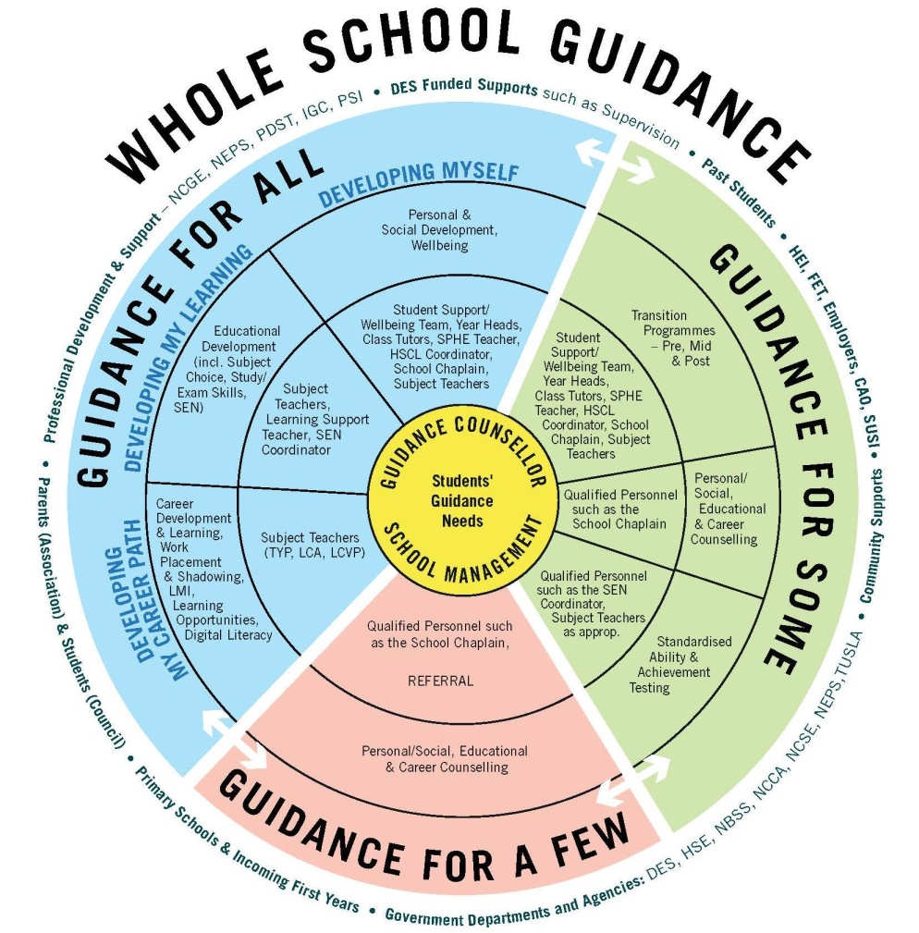
Continuum of Support Model: WSG
Overview:
Guidance for All
Guidance for Some
Guidance for A Few

Slide 14
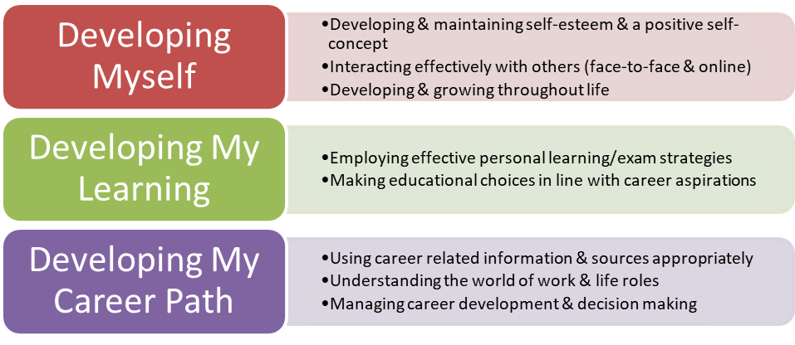
WSG: Guidance for All

Slide 15
WSG: Guidance for Some

Slide 16
WSG: Guidance for a Few

Slide 17
WSG: Students’ Guidance Needs

Slide 18
NCGE Resources & Supports
Pilot Programme
18 Schools (3 ETBs)
Resources & Supports
Planning the programme/service
Designing the programme/service
Delivering learning experiences

Slide 19
Over to you!
Discuss the whole school guidance wheel – what are your key observations/is it a useful representation of WSG?
How could you use the Wheel in your school to start a conversation on whole school guidance?

Slide 20
jennifer.mckenzie@ncge.ie linda.darbey@ncge.ie ncgeinfo@ncge.ie
www.ncge.ie
www.ncge.ie/school-guidance-handbook/
@ncgeguidance
Thank you

